Slide 1
DOS/DDOS ATTACK SIMPLIFIED

Slide 2


Slide 3


Slide 4
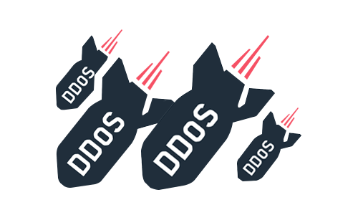
What is DOS/DDOS ATTACK?
DDoS attacks are a subclass of denial of service (DoS) attacks.
A DDoS attack involves multiple connected online devices, collectively known as a botnet, which are used to overwhelm a target website with fake traffic.

Slide 5

Let’s take a practical example:
Server
Your email Inbox
Receive
Read
Reply

Slide 6


The Pizza Party invitation
But Rahul, keeps sending you tons of spam messages.
Prashant sends you an email invitation to a Pizza Party.
You fail to respond to Prashant’s invitation in time, because you are too busy replying to Rahul’s Spam messages.

Slide 7
This is called DOS/Denial of Service Attack

Slide 8
Simple Solution- IP Blacklisting
Read the sender on top of the mail before opening it.
This way you don’t need to reply to Rahul and can focus on handling serious stuff, like Pizzas.
This is IP Blacklisting in a nutshell.

Slide 9

BUT RAHUL DOESN’T STOP THERE!!

Slide 10
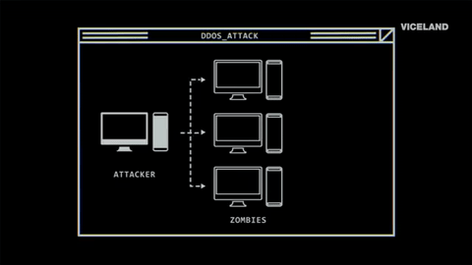
Rahul forced a lot of other evil people to send you Spam mails.
This is called Botnet
So now you can’t simply discard Rahul’s mails, because there are lots of people writing you.
This is called Distributed Denial of Service Attack (DDOS Attack).

Slide 11
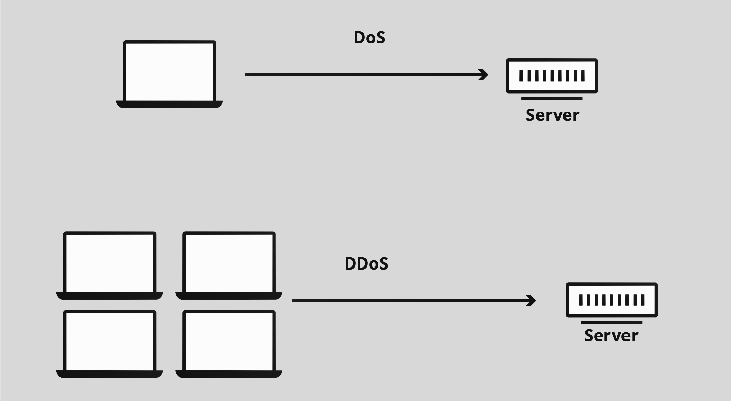

Slide 12
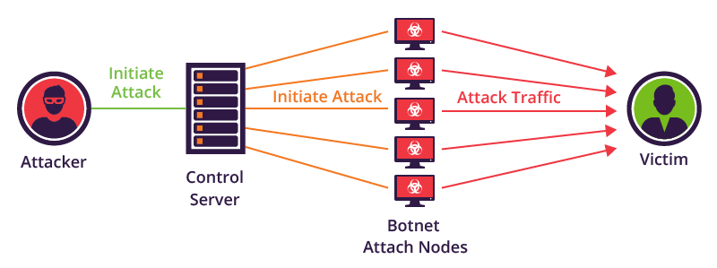

Malware infected systems

Slide 13

OMG! TOO MUCH TO HANDLE!

Slide 14
An Okayish Solution - IP Whitelisting
One way to handle this is to receive mail only from Prashant.
But your other genuine also friends won’t be able to write you, because you will discard their emails too.
So increase the number of legitimate people you’d like to receive mail from.
This is called IP Whitelisting and can be used to mitigate the impact of a DDoS attack.

Slide 15

Business Competition
Hacktivism
Script Kiddies
Why DDOS?

Slide 16
Some DDOS Attack Methods
ICMP Flood:
  Sends packets to all computer hosts rather than a specific machine
Teardrop Attack:
  Fragmented oversized play-loads to be sent to the target machine
Permanent denial-of-service attacks:
  May cause replacement of hardware

Slide 17
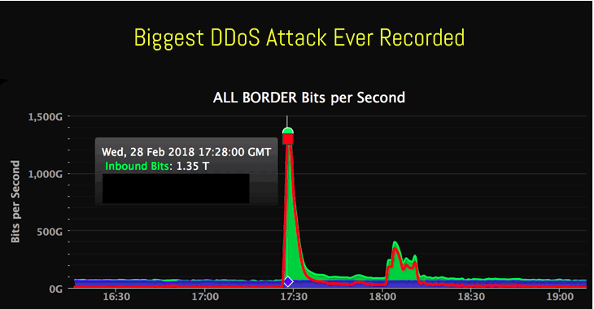
28th February, 2018
GitHub hit with the largest-ever DDoS attack that peaked at record 1.35 Tbps

Slide 18
Attackers used misconfigured Memcached servers to amplify the DDoS attack.
Memcached servers are designed to cache data and speed up web applications and internet sites.
Attackers simply spoof the IP address of their victim.
And send small queries to multiple memcached servers—about 10 per second per server—that are designed to elicit a much larger response.
The memcached systems then return 50 times the data of the requests back to the victim.
What happened in the attack?

Slide 19
How did Github Brave this huge attack?
Github was awesomely prepared for much bigger attacks!
GitHub called in assistance from
Akamai Prolexic
Rerouted traffic to GitHub through its
"scrubbing" centers.
Removed and blocked data deemed to be malicious.

Slide 20



Slide 21
SOLUTION TO DDOS ATTACKS

Slide 22
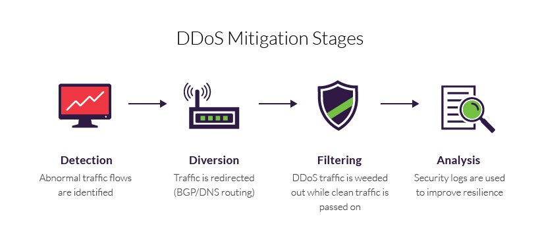

Slide 23
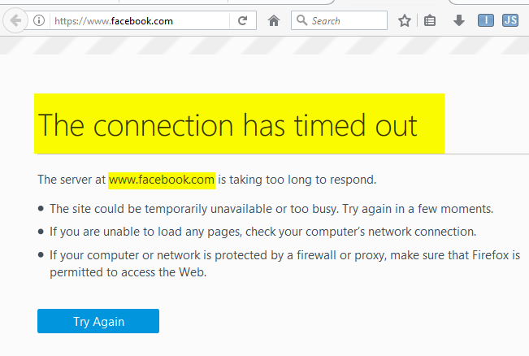
Detection
Unusually slow network performance (opening files or accessing websites)
Unavailability of a particular website
Inability to access websites
A dramatic increase in the number of spam emails receive

Slide 24
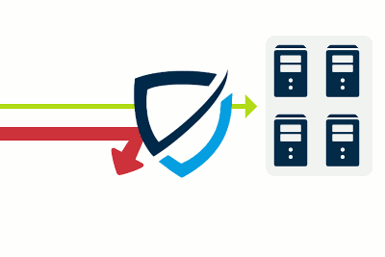
2. Diversion
Traffic is rerouted away from its target.
Either to be filtered or completely discarded.

Slide 25

Need to identify patterns that instantly distinguish between legitimate traffic and malicious visitors.
Responsiveness is a function of your being able to block an attack without interfering with your users’ experience.
3. Filtering

Slide 26

4. Analysis
Security logs are reviewed to gather information about the attack.
To identify the offender(s).
And to improve future resilience.

Slide 27

Precaution
Explore dedicated anti-DDoS solutions on the market.
Decide which vendor/solution provider to call if the need arises.
It's like choosing your doctor before you get sick.

Slide 28
Conclusion
Now, it’s important that companies make sure they prepare themselves.
Technology firms will continue to work to take down DDoS botnets like WireX.
However, organizations should make sure they’ve protected themselves with DDoS mitigation technologies in the meantime.

Slide 29
References
Wired: https://www.wired.com/story/github-ddos-memcached/
Security Planet: https://www.esecurityplanet.com/network-security/5-tips-for-fighting-ddos-attacks.html
Wikipedia: https://en.wikipedia.org/wiki/Denial-of-service_attack
Znet: http://www.zdnet.com/article/memcached-ddos-the-biggest-baddest-denial-of-service-attacker-yet/

Slide 30



Thanks for your patience!
Any questions?
github.com/AindriyaBarua
+91 878 776 8696
barua.aindriya@gmail.com

